Slide 1
AIと共に進むAMD FPGAデザインフロー
Vivado ML
実デザインを基にストラテージを調整
Vivado Chat
AMDドキュメントでハルシネーションを避ける
Vivado AI assist
AI駆動FPGAデザイン

Slide 2
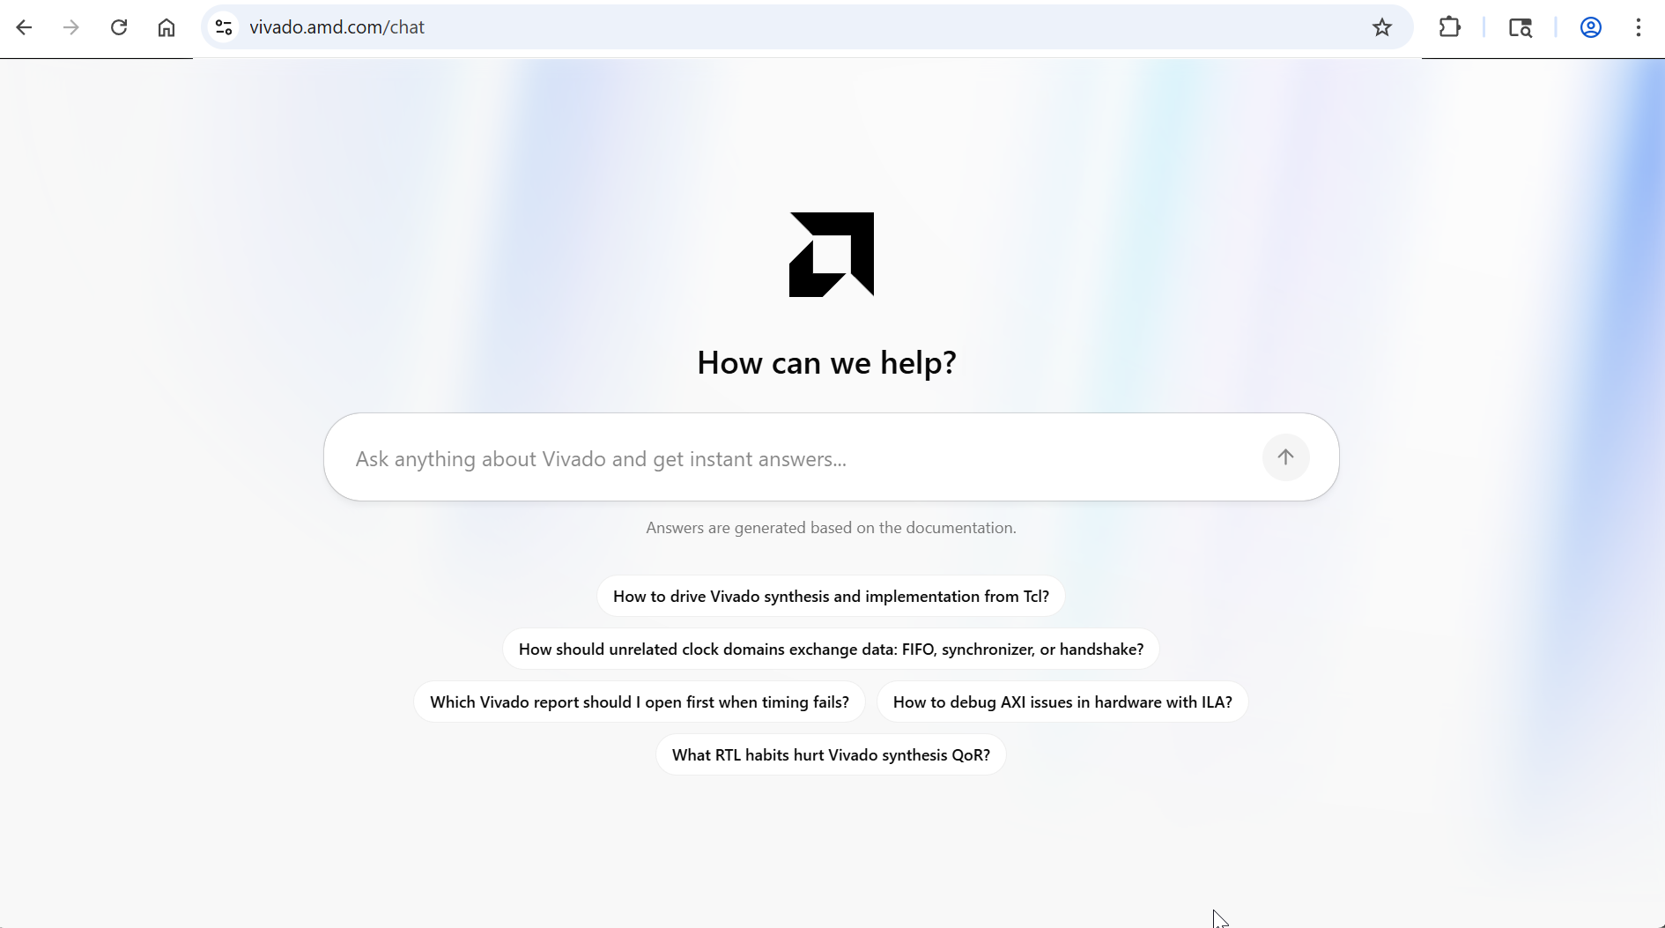
A One-Stop Shop for AMD Vivado IDE Queries
Access the AMD knowledge base via a web portal: vivado.amd.com/chat
Notes:
In addition to the MCP server, you can access the AMD knowledge base through a simple web portal.
Go to vivado.amd.com/chat and ask natural language questions—no Vivado installation or IDE setup required. This is ideal for system architects evaluating devices, comparing IPs, or exploring design options before they have a project open in Vivado.
The web portal connects to the same AMD network-hosted documentation database, ensuring you receive the same retrieval-augmented generation (RAG) powered responses—with citations—as the MCP server. It is a one-stop shop for any Vivado IDE or AMD device-related question, accessible from any browser.

Slide 3
Vivado AI chatの登場！
AMDドキュメントファーストの検索
  RAG(Retrieval-Augmented Generation：検索拡張生成）手法を使って生成AIが他ドキュメントに彷徨い出るのを防止
  複数の考え方、方法がある場合でもまずAMDの考え方、方法を優先して検索する。
  AMD社内ベンチマークで、RAG無しに比べて高スコアを獲得 ( RAG無し 56点、RAG経由 81点)
  ドキュメントに加えAR(answer record)を探すことで実デザイン事例に即した回答が得られる。
完全に無料公開中
  Vivado などのライセンス不要、AMDアカウント不要、登録不要。
AMD Vivado AI assistのベースの１つになる。
  AIを使い、コマンドを直接入力することなく会話的にデザインを行い、問題点を解決していく。
  近日一般公開予定。現在EA(Early access)公開中。

Slide 4
Vivado AI chatの登場！
使いやすいインターフェース
  プラグイン無しで、ブラウザ経由のアクセスのみで完結。
  各国語対応。日本語で質問した時には日本語で回答する。
  質問履歴の保存。Cookie を使ってユーザーと質問コンテキストを保存。(推測)
説明可能性の保持
  参照したドキュメントの一覧を表示。
  関連事項の確認が簡単になる。

Slide 5
Vivado AI chatでできること
AMDデバイス、デザインツールの用語の意味を詳細に知る。
  セットアップ➔ 衣料業界にも同じ用語がある。
  リセットの極性 ➔ FPGAではポジティブハイが普通。また同期リセットを推奨
ツールの版数依存の問題を分析できる。
  指定がないといは、最新の2026.1のドキュメントが使われる。
  過去のすべての版数が対象になる。IESも対象。
デザインの分析。
  XDCなどをアップロードして分析できる。
  適切なメソドロジガイド、分析コマンドの使用方法を得られる。➔同じ方法を繰り返し使うことができる。
デザイン例の作成
  特定のシナリオに沿ったIPの使用例を得られる。
  Verilog / VHDL / XDC の記述例を得ることができる。(generate 文の使い方、|=> の使い方など)

Slide 6
Access Knowledge Base: Real Questions, Expert Answers
System Architect
RTL Developer
Timing Closure Specialist
Hardware Debug Specialist
How to configure NoC for optimal bandwidth?
How to constrain async clock domain crossings?
How to fix setup violations on high-fanout nets?
PDI boot failure troubleshooting on AMD Versal devices?
→ UG1388, UG1504, PG313
Use traffic classes (Best Effort, Isochronous, Low Latency)
with bandwidth allocation per route
→ UG903, UG1387, UG949
Use XPM_CDC macros. Apply ASYNC_REG attributes
set_false_path / set_max_delay constraints
→ UG949, UG1387, AR#53430
Use report_high_fanout_nets after synthesis
Apply MAX_FANOUT or manual replication
→ UG1304, UG908, AR#76655
Check boot mode pins (SW1). Verify PDI in JTAG/flash/SD
Boot via HW Manager. Check PMC error codes
Which AMD Versal™ device supports my AI inference workload?
RTL coding best practices for synthesis?
What phys_opt_design techniques help timing?
DDR calibration debug using DDRMC in the AMD Vivado™ tool?
→ DS957, UG1504
Versal AI Edge (VE2302, VE2802) with integrated AI Engines
for INT8/INT4 inference. 400+ TOPS
→ UG901, UG1387, UG949
Follow UG901 guidelines. Use RAM_STYLE, SHREG_EXTRACT,
MAX_FANOUT attributes. Avoid latches
→ UG904, UG949, UG1387
Post-place and post-route phys_opt_design.
Use -fanout_opt, -placement_opt, -retime
→ UG908
DDRMC debug always enabled in Versal devices. HW Manager reads
calibration status, R/W window margins
Powered by RAG—500+ User Guides, Application Notes & Knowledge Base Articles
UG903 · UG904 · UG908 · UG949 · UG1387 · UG1388 · UG1504 · PG313 · DS957 · AM011 · UG901 · AR Articles · and more
Notes:
This slide shows what the knowledge base looks like from a user's perspective across different roles.
A system architect can ask how to configure NoC for optimal bandwidth and get a precise answer citing UG1388 and PG313—with traffic class recommendations and bandwidth allocation guidance.
An RTL developer can ask which about constraining async clock domain crossings and get the exact XPM_CDC macros, ASYNC_REG attributes, and set_false_path syntax from UG903 and UG949.
A timing closure specialist can ask how to fix setup violations on high-fanout nets and quickly get guidance, including the use of the report_high_fanout_nets command and recommended optimization techniques.
A hardware debug specialist can ask about troubleshooting PDI boot failures and receive targeted insights on where to debug on the board and how to narrow down the root cause.
Every response cites the source document and links to the specific section—not just the document title.

Slide 7
Deep Dive: Knowledge Database
COVERAGE
What's Inside
SMART TAGGING
How It's Organized
INTELLIGENT SEARCH
How It Finds Answers
CONTEXT AWARENESS
Why It's Better
Cross-referenced Answers
Web documentation
PDF user & product guides
Knowledge base (answer records)
Blog articles & design tips
Embedded wiki (Linux®,
u-boot)
Github reference designs
Source Classification
Web docs
Knowledge base
PDF docs
Dual Retrieval Engine
Keyword matching for TCL commands, register names, error codes
Semantic understanding for natural language questions
Cross-Referenced Answers
Results link to related docs
e.g., UG949 → UG903 → UG1387
Design advisories auto-surfaced
Blog
Wiki
GitHub
Document ID Taxonomy
UG
PG
DS
WP
AR#
AM
Design-Phase Mapping
Matches query to design stage
RTL → Synth → Impl → Debug
Phase-appropriate doc priority
Flexible Search Modes
Precision: exact term lookup
Balanced: keyword + semantic
Exploration: intent-based discovery
Product & Tool Coverage
AMD Versal™ AI Edge / Premium / HBM
Zynq™ UltraScale+™ MPSoC & RFSoC
AMD 7 Series, Spartan™ 6, Virtex™ 6/5 FPGAs
Vivado™ IDE, Vitis™ software platform, PetaLinux, ISE™ design suite
Section-Level Indexing
Deep links to exact doc sections
UG903 → Async Clock groups
UG1304 → PLM responsibilities
UG949 → CDC methodology
Actionable Responses
Full context excerpts, not titles
Tcl commands included inline
Step-by-step guidance from UGs
Result Control
Adjustable depth: focused answer to comprehensive survey
Every result cites doc ID + URL
Notes:
Let’s go deeper into what makes the knowledge base powerful.
On coverage—the database includes web documentation, PDF user and product guides, knowledge base answer records, blog articles, the embedded Linux and U-Boot wiki, and GitHub reference designs. It spans AMD Versal, UltraScale+, and older device families, and includes documentation for all the associated tools—Vivado, Vitis, PDM, ChipScope, and Model Composer.
Smart tagging is what makes retrieval intelligent. Every document is classified by source type, tagged with document IDs like UG or PG or AR, and indexed at section level—so results point to the exact section within a thousand-page user guide, not just the top-level document.
The search engine supports three modes—precision for exact term lookup, balanced for keyword plus semantic understanding, and exploration for pure intent-based discovery.
And context awareness means the agent can correlate the search results against your actual design, so recommendations are tailored to your specific project rather than being generic.

Slide 8
Deep Dive: Knowledge Database
COVERAGE
What's Inside
SMART TAGGING
How It's Organized
INTELLIGENT SEARCH
How It Finds Answers
CONTEXT AWARENESS
Why It's Better
Cross-referenced Answers
Web documentation
PDF user & product guides
Knowledge base (answer records)
Blog articles & design tips
Embedded wiki (Linux®,
u-boot)
Github reference designs
Source Classification
Web docs
Knowledge base
PDF docs
Dual Retrieval Engine
Keyword matching for TCL commands, register names, error codes
Semantic understanding for natural language questions
Cross-Referenced Answers
Results link to related docs
e.g., UG949 → UG903 → UG1387
Design advisories auto-surfaced
Blog
Wiki
GitHub
AMDドキュメントファースト
Document ID Taxonomy
UG
PG
DS
WP
AR#
AM
Design-Phase Mapping
Matches query to design stage
RTL → Synth → Impl → Debug
Phase-appropriate doc priority
Flexible Search Modes
Precision: exact term lookup
Balanced: keyword + semantic
Exploration: intent-based discovery
Product & Tool Coverage
AMD Versal™ AI Edge / Premium / HBM
Zynq™ UltraScale+™ MPSoC & RFSoC
AMD 7 Series, Spartan™ 6, Virtex™ 6/5 FPGAs
Vivado™ IDE, Vitis™ software platform, PetaLinux, ISE™ design suite
Section-Level Indexing
Deep links to exact doc sections
UG903 → Async Clock groups
UG1304 → PLM responsibilities
UG949 → CDC methodology
Actionable Responses
Full context excerpts, not titles
Tcl commands included inline
Step-by-step guidance from UGs
Result Control
Adjustable depth: focused answer to comprehensive survey
Every result cites doc ID + URL
Notes:
Let’s go deeper into what makes the knowledge base powerful.
On coverage—the database includes web documentation, PDF user and product guides, knowledge base answer records, blog articles, the embedded Linux and U-Boot wiki, and GitHub reference designs. It spans AMD Versal, UltraScale+, and older device families, and includes documentation for all the associated tools—Vivado, Vitis, PDM, ChipScope, and Model Composer.
Smart tagging is what makes retrieval intelligent. Every document is classified by source type, tagged with document IDs like UG or PG or AR, and indexed at section level—so results point to the exact section within a thousand-page user guide, not just the top-level document.
The search engine supports three modes—precision for exact term lookup, balanced for keyword plus semantic understanding, and exploration for pure intent-based discovery.
And context awareness means the agent can correlate the search results against your actual design, so recommendations are tailored to your specific project rather than being generic.

Slide 9
Deep Dive: Knowledge Database
COVERAGE
What's Inside
SMART TAGGING
How It's Organized
INTELLIGENT SEARCH
How It Finds Answers
CONTEXT AWARENESS
Why It's Better
Cross-referenced Answers
Web documentation
PDF user & product guides
Knowledge base (answer records)
Blog articles & design tips
Embedded wiki (Linux®,
u-boot)
Github reference designs
Source Classification
Web docs
Knowledge base
PDF docs
Dual Retrieval Engine
Keyword matching for TCL commands, register names, error codes
Semantic understanding for natural language questions
Cross-Referenced Answers
Results link to related docs
e.g., UG949 → UG903 → UG1387
Design advisories auto-surfaced
Blog
Wiki
GitHub
長期にわたる検索範囲
Document ID Taxonomy
UG
PG
DS
WP
AR#
AM
Design-Phase Mapping
Matches query to design stage
RTL → Synth → Impl → Debug
Phase-appropriate doc priority
Flexible Search Modes
Precision: exact term lookup
Balanced: keyword + semantic
Exploration: intent-based discovery
Product & Tool Coverage
AMD Versal™ AI Edge / Premium / HBM
Zynq™ UltraScale+™ MPSoC & RFSoC
AMD 7 Series, Spartan™ 6, Virtex™ 6/5 FPGAs
Vivado™ IDE, Vitis™ software platform, PetaLinux, ISE™ design suite
Section-Level Indexing
Deep links to exact doc sections
UG903 → Async Clock groups
UG1304 → PLM responsibilities
UG949 → CDC methodology
Actionable Responses
Full context excerpts, not titles
Tcl commands included inline
Step-by-step guidance from UGs
Result Control
Adjustable depth: focused answer to comprehensive survey
Every result cites doc ID + URL
Notes:
Let’s go deeper into what makes the knowledge base powerful.
On coverage—the database includes web documentation, PDF user and product guides, knowledge base answer records, blog articles, the embedded Linux and U-Boot wiki, and GitHub reference designs. It spans AMD Versal, UltraScale+, and older device families, and includes documentation for all the associated tools—Vivado, Vitis, PDM, ChipScope, and Model Composer.
Smart tagging is what makes retrieval intelligent. Every document is classified by source type, tagged with document IDs like UG or PG or AR, and indexed at section level—so results point to the exact section within a thousand-page user guide, not just the top-level document.
The search engine supports three modes—precision for exact term lookup, balanced for keyword plus semantic understanding, and exploration for pure intent-based discovery.
And context awareness means the agent can correlate the search results against your actual design, so recommendations are tailored to your specific project rather than being generic.

Slide 10
Deep Dive: Knowledge Database
参照ドキュメントを使った思考過程の説明
参照ドキュメントを使った思考過程の説明
COVERAGE
What's Inside
SMART TAGGING
How It's Organized
INTELLIGENT SEARCH
How It Finds Answers
CONTEXT AWARENESS
Why It's Better
Cross-referenced Answers
Web documentation
PDF user & product guides
Knowledge base (answer records)
Blog articles & design tips
Embedded wiki (Linux®,
u-boot)
Github reference designs
Source Classification
Web docs
Knowledge base
PDF docs
Dual Retrieval Engine
Keyword matching for TCL commands, register names, error codes
Semantic understanding for natural language questions
Cross-Referenced Answers
Results link to related docs
e.g., UG949 → UG903 → UG1387
Design advisories auto-surfaced
Blog
Wiki
GitHub
Document ID Taxonomy
UG
PG
DS
WP
AR#
AM
Design-Phase Mapping
Matches query to design stage
RTL → Synth → Impl → Debug
Phase-appropriate doc priority
Flexible Search Modes
Precision: exact term lookup
Balanced: keyword + semantic
Exploration: intent-based discovery
Product & Tool Coverage
AMD Versal™ AI Edge / Premium / HBM
Zynq™ UltraScale+™ MPSoC & RFSoC
AMD 7 Series, Spartan™ 6, Virtex™ 6/5 FPGAs
Vivado™ IDE, Vitis™ software platform, PetaLinux, ISE™ design suite
Section-Level Indexing
Deep links to exact doc sections
UG903 → Async Clock groups
UG1304 → PLM responsibilities
UG949 → CDC methodology
Actionable Responses
Full context excerpts, not titles
Tcl commands included inline
Step-by-step guidance from UGs
Result Control
Adjustable depth: focused answer to comprehensive survey
Every result cites doc ID + URL
Notes:
Let’s go deeper into what makes the knowledge base powerful.
On coverage—the database includes web documentation, PDF user and product guides, knowledge base answer records, blog articles, the embedded Linux and U-Boot wiki, and GitHub reference designs. It spans AMD Versal, UltraScale+, and older device families, and includes documentation for all the associated tools—Vivado, Vitis, PDM, ChipScope, and Model Composer.
Smart tagging is what makes retrieval intelligent. Every document is classified by source type, tagged with document IDs like UG or PG or AR, and indexed at section level—so results point to the exact section within a thousand-page user guide, not just the top-level document.
The search engine supports three modes—precision for exact term lookup, balanced for keyword plus semantic understanding, and exploration for pure intent-based discovery.
And context awareness means the agent can correlate the search results against your actual design, so recommendations are tailored to your specific project rather than being generic.

Slide 11
Deep Dive: Knowledge Database
シンプル検索とベクター化検索のミックス
COVERAGE
What's Inside
SMART TAGGING
How It's Organized
INTELLIGENT SEARCH
How It Finds Answers
CONTEXT AWARENESS
Why It's Better
Cross-referenced Answers
Web documentation
PDF user & product guides
Knowledge base (answer records)
Blog articles & design tips
Embedded wiki (Linux®,
u-boot)
Github reference designs
Source Classification
Web docs
Knowledge base
PDF docs
Dual Retrieval Engine
Keyword matching for TCL commands, register names, error codes
Semantic understanding for natural language questions
Cross-Referenced Answers
Results link to related docs
e.g., UG949 → UG903 → UG1387
Design advisories auto-surfaced
Blog
Wiki
GitHub
Document ID Taxonomy
UG
PG
DS
WP
AR#
AM
Design-Phase Mapping
Matches query to design stage
RTL → Synth → Impl → Debug
Phase-appropriate doc priority
Flexible Search Modes
Precision: exact term lookup
Balanced: keyword + semantic
Exploration: intent-based discovery
Product & Tool Coverage
AMD Versal™ AI Edge / Premium / HBM
Zynq™ UltraScale+™ MPSoC & RFSoC
AMD 7 Series, Spartan™ 6, Virtex™ 6/5 FPGAs
Vivado™ IDE, Vitis™ software platform, PetaLinux, ISE™ design suite
Section-Level Indexing
Deep links to exact doc sections
UG903 → Async Clock groups
UG1304 → PLM responsibilities
UG949 → CDC methodology
Actionable Responses
Full context excerpts, not titles
Tcl commands included inline
Step-by-step guidance from UGs
Result Control
Adjustable depth: focused answer to comprehensive survey
Every result cites doc ID + URL
Notes:
Let’s go deeper into what makes the knowledge base powerful.
On coverage—the database includes web documentation, PDF user and product guides, knowledge base answer records, blog articles, the embedded Linux and U-Boot wiki, and GitHub reference designs. It spans AMD Versal, UltraScale+, and older device families, and includes documentation for all the associated tools—Vivado, Vitis, PDM, ChipScope, and Model Composer.
Smart tagging is what makes retrieval intelligent. Every document is classified by source type, tagged with document IDs like UG or PG or AR, and indexed at section level—so results point to the exact section within a thousand-page user guide, not just the top-level document.
The search engine supports three modes—precision for exact term lookup, balanced for keyword plus semantic understanding, and exploration for pure intent-based discovery.
And context awareness means the agent can correlate the search results against your actual design, so recommendations are tailored to your specific project rather than being generic.

Slide 12
Deep Dive: Knowledge Database
COVERAGE
What's Inside
SMART TAGGING
How It's Organized
INTELLIGENT SEARCH
How It Finds Answers
CONTEXT AWARENESS
Why It's Better
Cross-referenced Answers
Web documentation
PDF user & product guides
Knowledge base (answer records)
Blog articles & design tips
Embedded wiki (Linux®,
u-boot)
Github reference designs
Source Classification
Web docs
Knowledge base
PDF docs
Dual Retrieval Engine
Keyword matching for TCL commands, register names, error codes
Semantic understanding for natural language questions
Cross-Referenced Answers
Results link to related docs
e.g., UG949 → UG903 → UG1387
Design advisories auto-surfaced
Blog
Wiki
GitHub
Document ID Taxonomy
UG
PG
DS
WP
AR#
AM
Design-Phase Mapping
Matches query to design stage
RTL → Synth → Impl → Debug
Phase-appropriate doc priority
Flexible Search Modes
Precision: exact term lookup
Balanced: keyword + semantic
Exploration: intent-based discovery
Product & Tool Coverage
AMD Versal™ AI Edge / Premium / HBM
Zynq™ UltraScale+™ MPSoC & RFSoC
AMD 7 Series, Spartan™ 6, Virtex™ 6/5 FPGAs
Vivado™ IDE, Vitis™ software platform, PetaLinux, ISE™ design suite
Section-Level Indexing
Deep links to exact doc sections
UG903 → Async Clock groups
UG1304 → PLM responsibilities
UG949 → CDC methodology
Actionable Responses
Full context excerpts, not titles
Tcl commands included inline
Step-by-step guidance from UGs
Result Control
Adjustable depth: focused answer to comprehensive survey
Every result cites doc ID + URL
Notes:
Let’s go deeper into what makes the knowledge base powerful.
On coverage—the database includes web documentation, PDF user and product guides, knowledge base answer records, blog articles, the embedded Linux and U-Boot wiki, and GitHub reference designs. It spans AMD Versal, UltraScale+, and older device families, and includes documentation for all the associated tools—Vivado, Vitis, PDM, ChipScope, and Model Composer.
Smart tagging is what makes retrieval intelligent. Every document is classified by source type, tagged with document IDs like UG or PG or AR, and indexed at section level—so results point to the exact section within a thousand-page user guide, not just the top-level document.
The search engine supports three modes—precision for exact term lookup, balanced for keyword plus semantic understanding, and exploration for pure intent-based discovery.
And context awareness means the agent can correlate the search results against your actual design, so recommendations are tailored to your specific project rather than being generic.

Slide 13

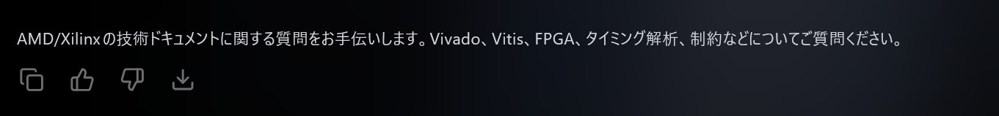


Slide 14
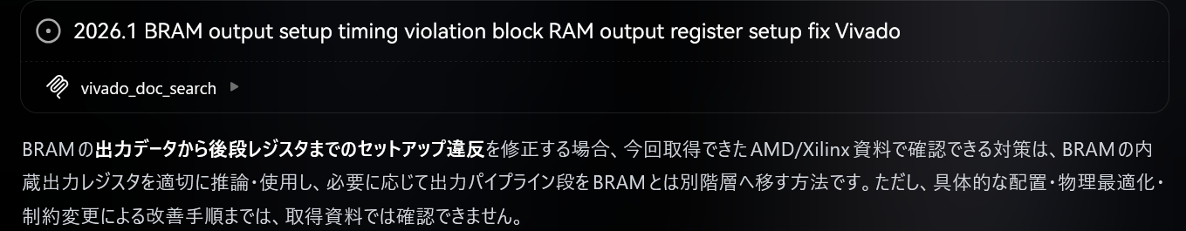

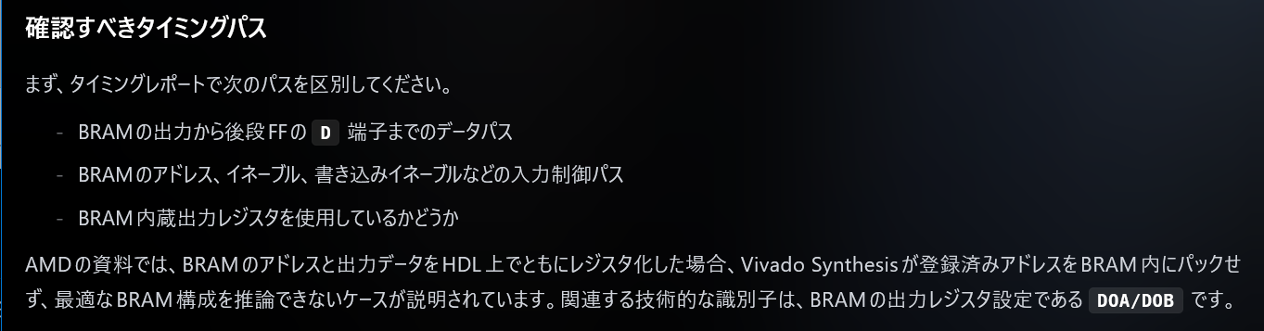
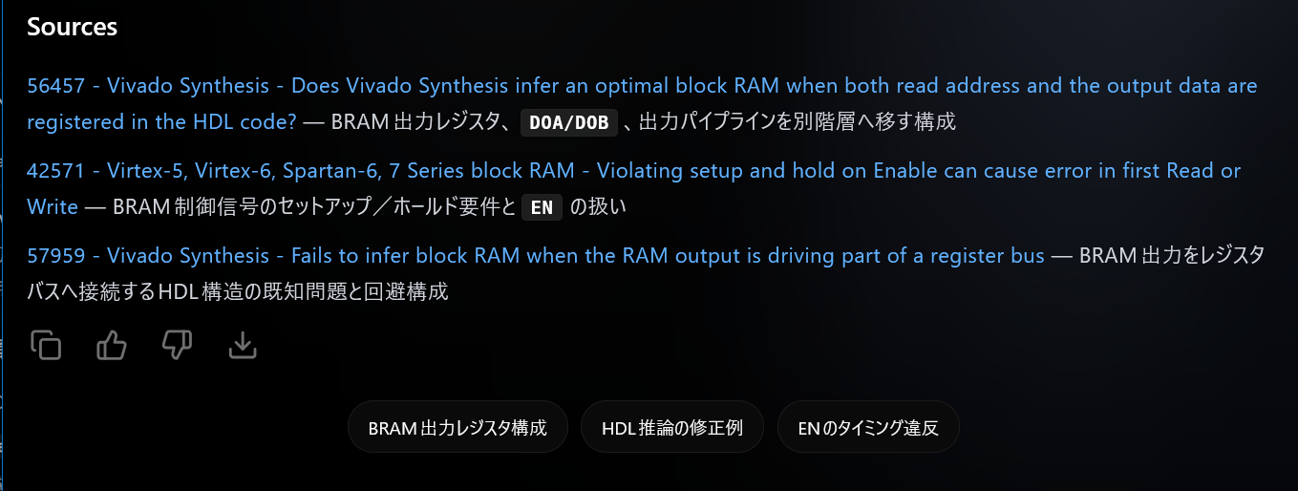
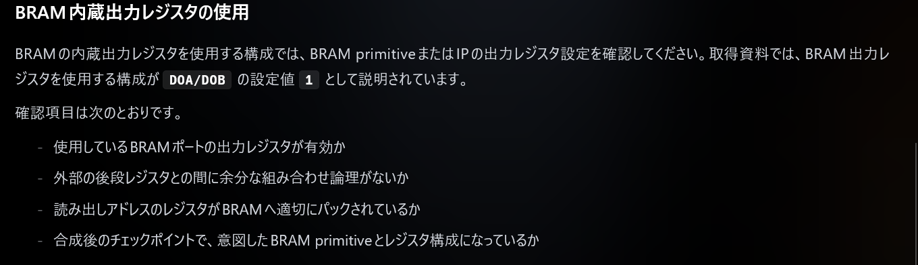
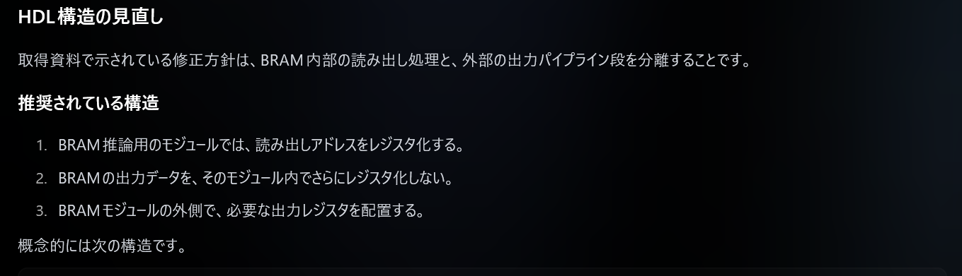
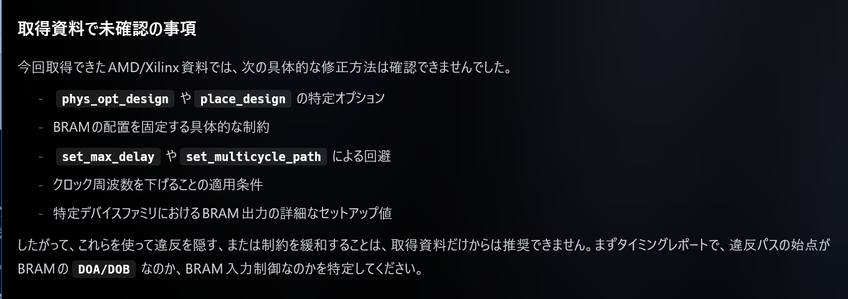
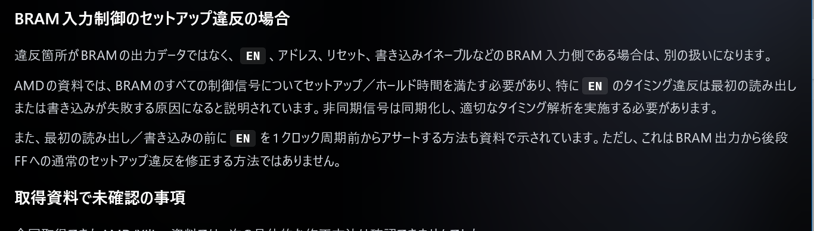
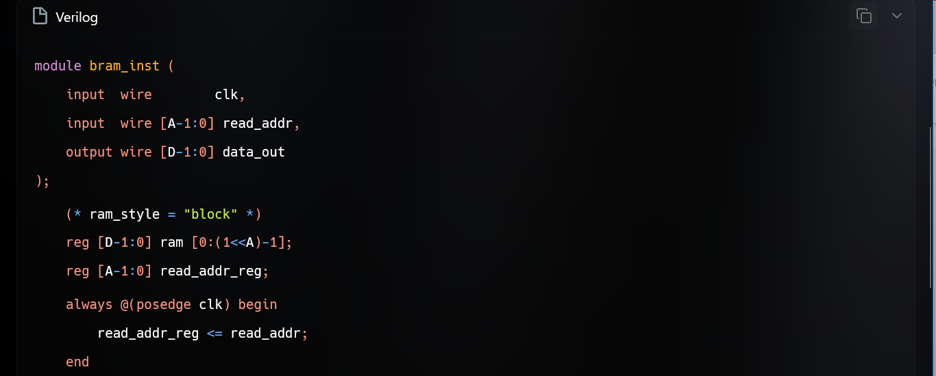
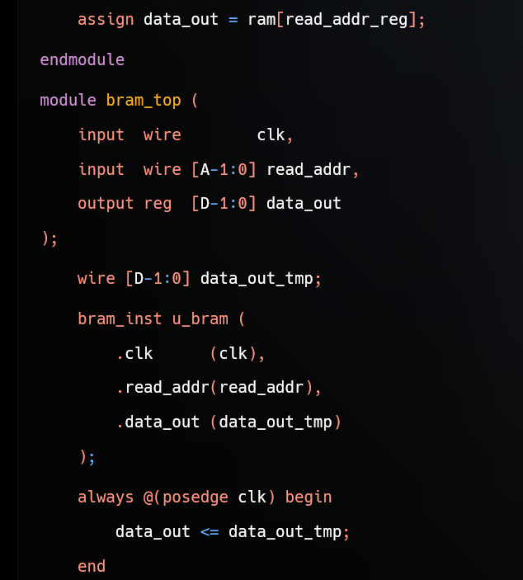


Vivado RAG chat live
Vivado RAG chat live

Slide 15
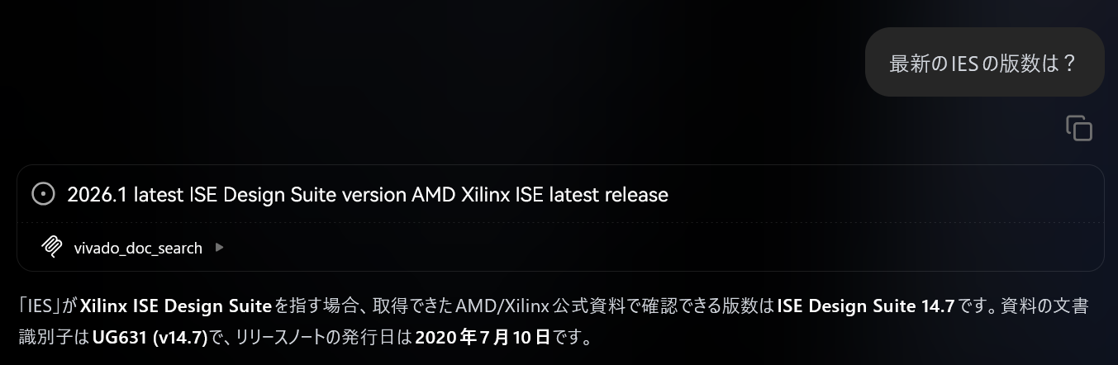

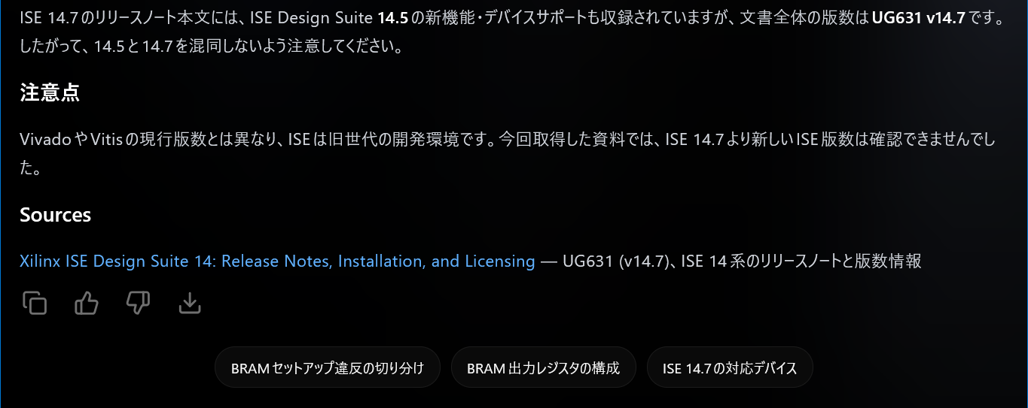
Vivado RAG chat live
Vivado RAG chat live

Slide 16

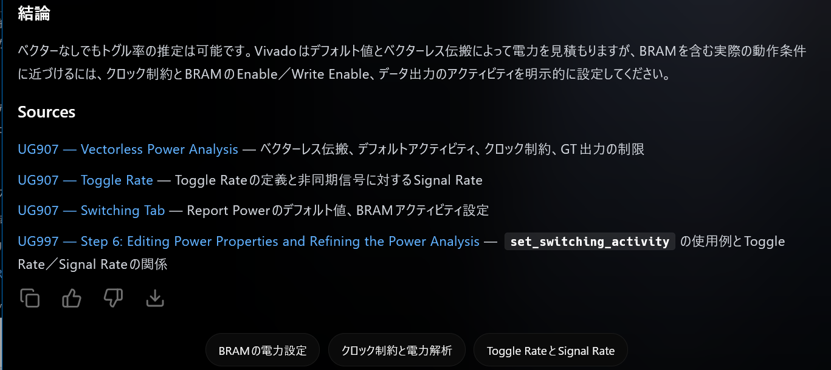
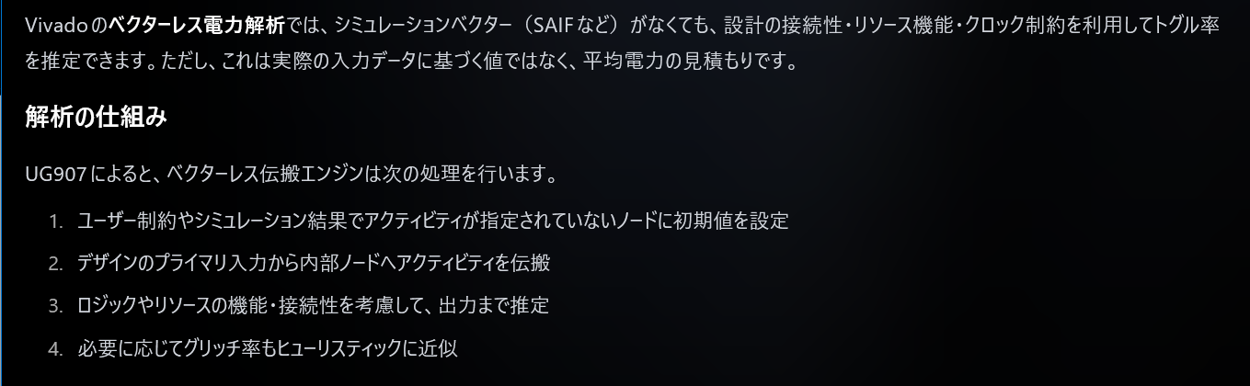

Vivado RAG chat live
Vivado RAG chat live

Slide 17



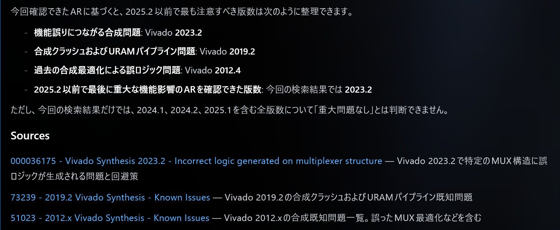


Vivado RAG chat live
Vivado RAG chat live

Slide 18

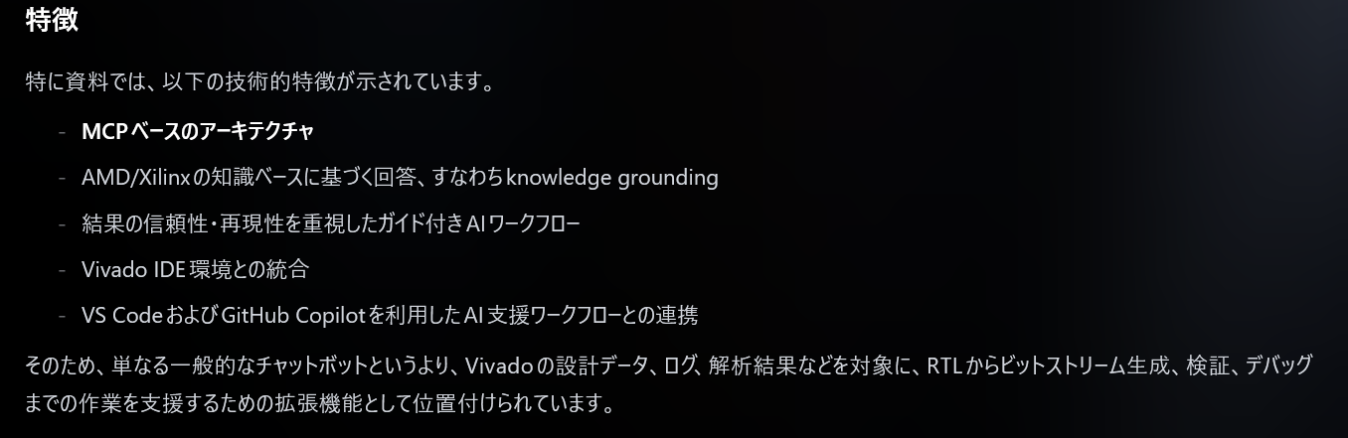
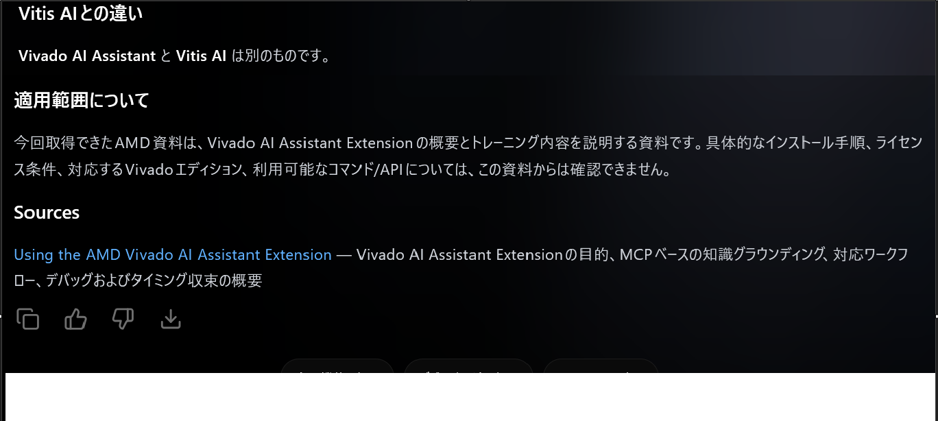
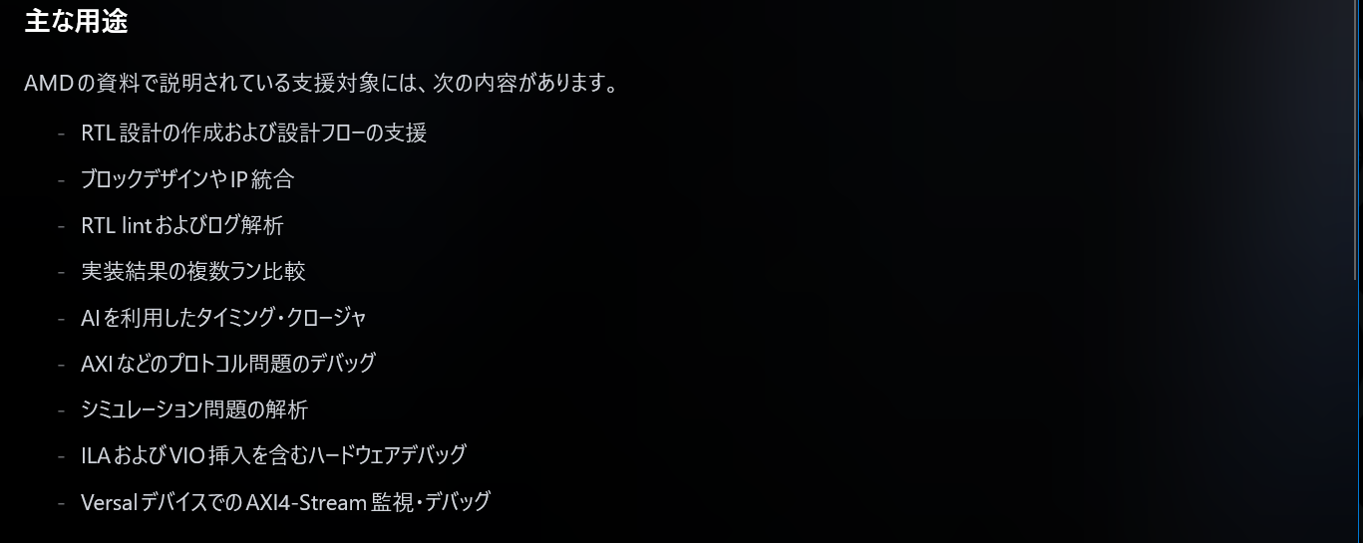
Vivado RAG chat live
Vivado RAG chat live

Slide 19
Disclaimer and Attributions
The information contained herein is for informational purposes only and is subject to change without notice. While every precaution has been taken in the preparation of this document, it may contain technical inaccuracies, omissions and typographical errors, and AMD is under no obligation to update or otherwise correct this information. Advanced Micro Devices, Inc. makes no representations or warranties with respect to the accuracy or completeness of the contents of this document, and assumes no liability of any kind, including the implied warranties of noninfringement, merchantability or fitness for particular purposes, with respect to the operation or use of AMD hardware, software or other products described herein. No license, including implied or arising by estoppel, to any intellectual property rights is granted by this document. Terms and limitations applicable to the purchase or use of AMD products are as set forth in a signed agreement between the parties or in AMD's Standard Terms and Conditions of Sale. GD-18u
© 2026 Advanced Micro Devices, Inc. All rights reserved. AMD, the AMD Arrow logo, ISE, Spartan, UltraScale+, Versal, Virtex, Vitis, Vivado, Zynq, and combinations thereof are trademarks of Advanced Micro Devices, Inc. Docker and the Docker logo are trademarks or registered trademarks of Docker, Inc. Linux is the registered trademark of Linus Torvalds in the U.S. and other countries. PCIe is a registered trademark of PCI-SIG Corporation. Visual Studio® is a registered trademark of Microsoft Corporation in the United States and/or other countries. Other product names used in this publication are for identification purposes only and may be trademarks of their respective owners. Certain AMD technologies may require third-party enablement or activation. Supported features may vary by operating system. Please confirm with the system manufacturer for specific features. No technology or product can be completely secure.

Slide 20
Notes:
Thank you for joining this session on AMD Vivado™ AI Assistant: Introduction.
For questions, reach out through the Early Access forum or the #vivado_general Slack channel.

